Slide 1


Order Returns data insights
From Jan-2009 to Dec-2012

Slide 2
Contents of this Presentation
Exploratory Data Analyses :
Appendix 1 : Data Integrity
Incoming Data , Cleaning , Checking , Assumptions
Appendix 2 : Future Improvements
Appendix 3 : Code-Base Brief Overview

Slide 3

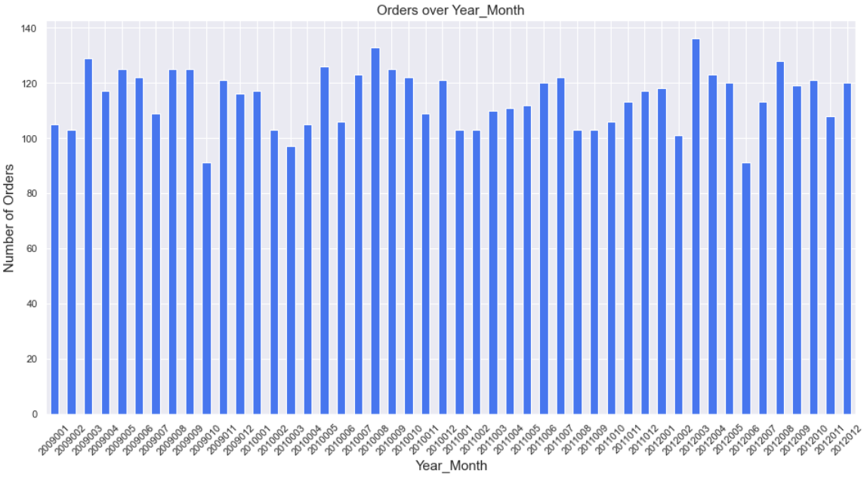



There is no observed growth in transaction volumes over the 3 year period

Slide 4
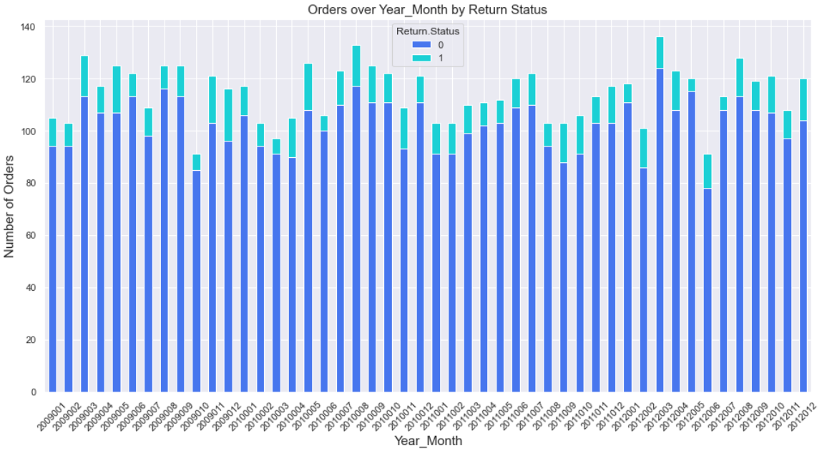
Near 10% orders have been returned in the history of 3 years

Slide 5
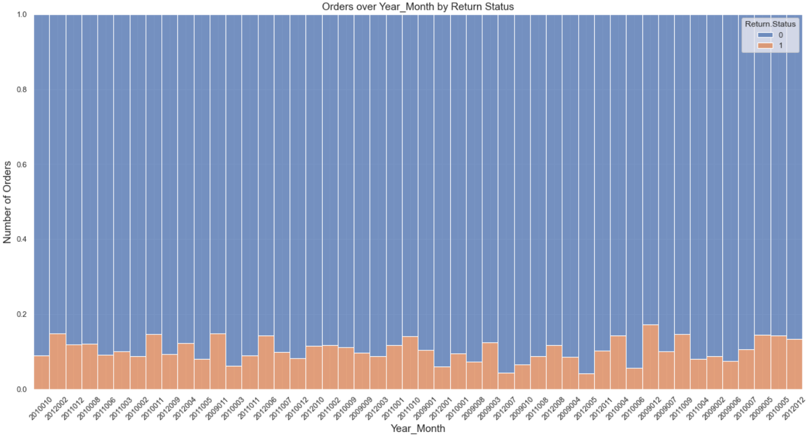
Volume Normalized view : This 10% order return rate has remained fairly constant over time

Slide 6
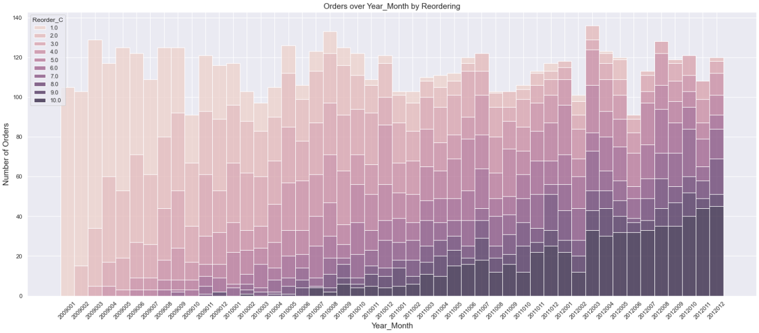
Customer Returns to buy different or even same Items Peach : New Customers ; Dark Purple : Customers who have placed >= 10 orders with company previously
Investigating Customer Loyalty At a Customer Level - whether a customer revisits the business,

Slide 7
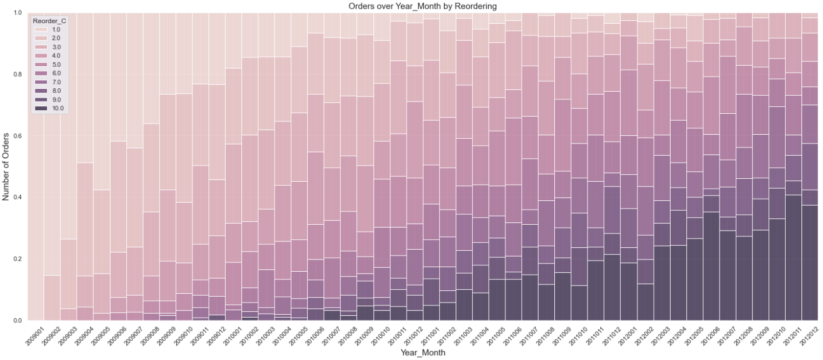
Normalized view : Share of Returning Customers the Customer Loyalty grows steadily ( when normalized for volumes )

Slide 8
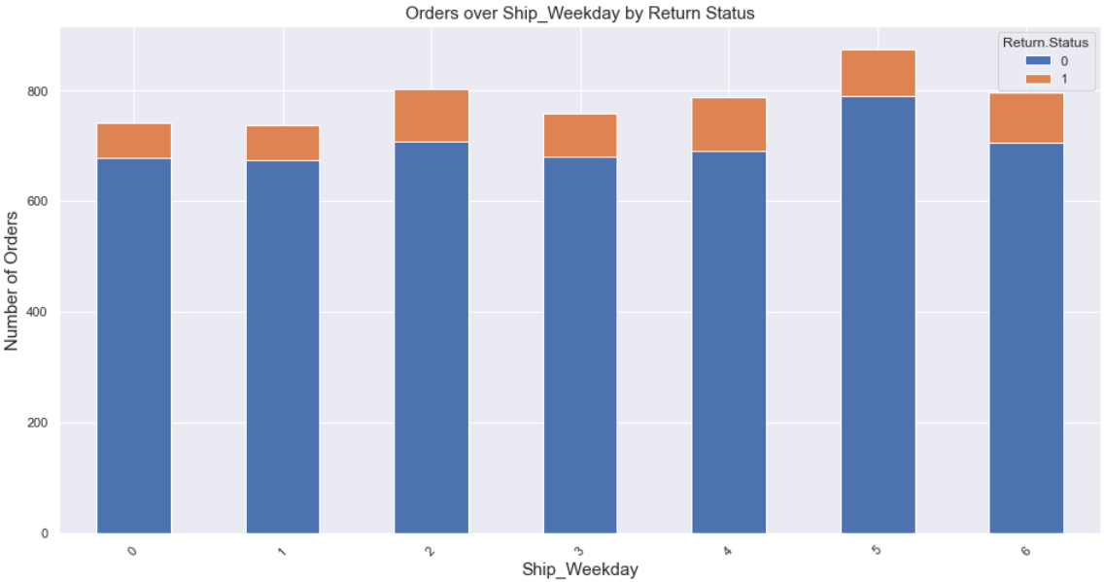
Weekend Seems to be an active Day with slightly more orders
Transactions Volumes in Day Level

Slide 9
Product and Price Dimension

Slide 10
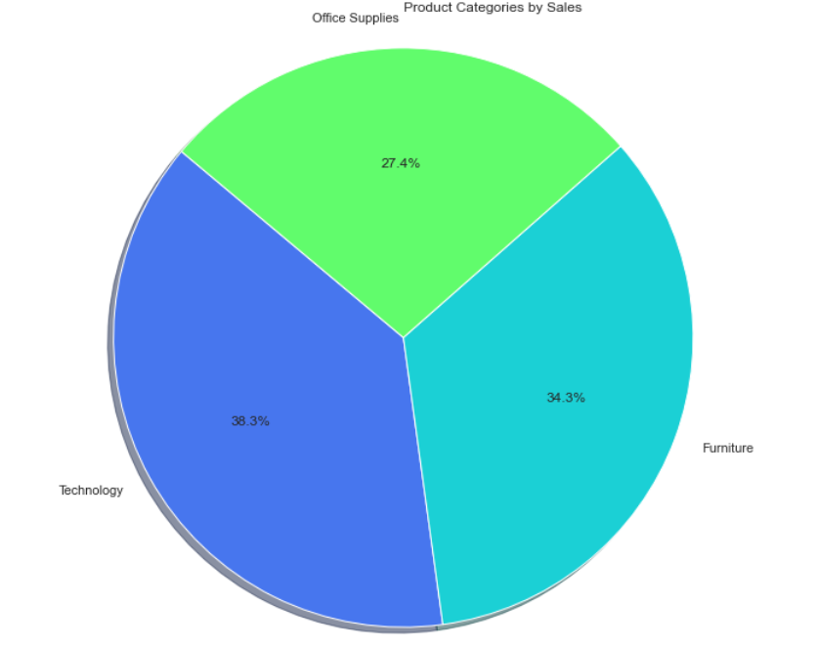
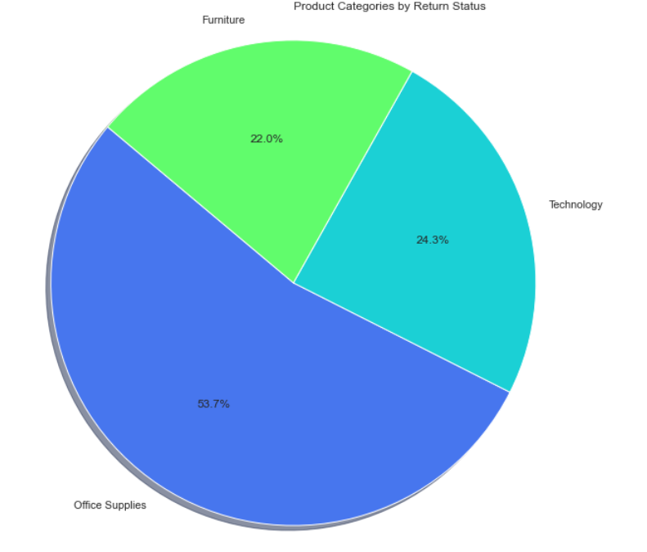
Product categories are fairly equally distributed in terms of Sales But office supplies contributes to more than 50% of Returns

Slide 11
Appendix 1
Data DEEP-DIVE

Slide 12
Steps In the Data Pipeline
Export Data from Incoming Excel to Create CSV dumps
Establish Logical Level of the Data
Data is supposed to be at Order.ID Level
There are no duplicate Data or Violations of Level
Type setting of Columns
Creation of Auxiliary Features (Time Dimension )
created from TimeStamp column : Order.Date , and Ship.Date
Levels : Year , Quarter , Month , Week , WeekDay , Day , Hour
Exported Final data for Consumption in Analysis

Slide 13
Appendix 2
Further Improvements AND NEXT STEPS

Slide 14
More things to try out
Rate of Sale Analysis :
Which item sells fast , which Items sell slow , and accordingly what are the rates of returns
80-20 analysis , which are the top products that get returned the most
RFM Analysis : Recency , Frequency , Monetary .
Augment analysis with Product Dimension Data
Top contributors to Sales : By Product , Department , RBU , Product-Age , HomeBrand etc
Augment with Customer Dimension Data like Age , Gender , First-Purchase-Date
“are our younger customers are likely to return more when normalized for age”

Slide 15
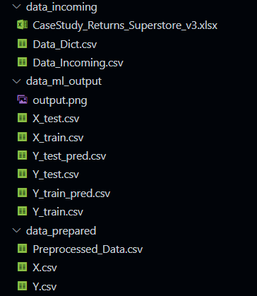
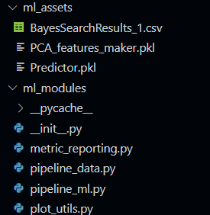
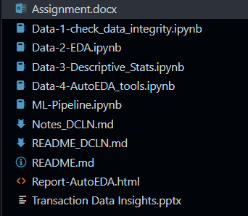
Appendix 3
Brief Code Base Over-View

Slide 16
Thank You
Saif. Raja
7775029864
saifuddin.raja24@gmail.com

